Slide 1

Welcome
Software Engineering – Best Practices
by
Girish Godbole

Slide 2
Agenda
Introduction to Software
Software Engineering
Software Process Models
Agile Scrum Methodology
Software Design Overview
Software Development Overview
Requirement Engineering
Software Testing & Integration

Slide 3

Who is he ?

Slide 4
Software Engineering - An Overview
Software -
“A set of executable programs in an application along with associated libraries and documentation”
“A set of instructions, data or programs used to operate computers and execute specific tasks.”
Engineering -
It is all about developing products, using well-defined, scientific principles and methods.”
Software Engineering -
“Software engineering is the systematic, disciplined, and quantifiable approach to the design, development, testing, implementation, and maintenance of application or computer systems software.”
Broadly, software engineering can be divided into two categories:
Application Engineering - Application engineering is the process of developing software applications for businesses and organizations
Systems Engineering - System engineering refers to the coordination of the development and maintenance of computer systems for businesses and organizations.

Slide 5
Software Engineering - Components
Components of Software
Program: A computer program is a list of instructions that tell a computer what to do.
Documentation: Source information about the product contained in design documents, detailed code comments, etc.
Operating Procedures: A set of step-by-step instructions compiled by an organization to help workers carry out complex routine operations.
Other Software Components
Code: the instructions that a computer executes to perform a specific task or set of tasks.
Data: the information that the software uses or manipulates.
User interface: how the user interacts with the software, such as buttons, menus, and text fields.
Libraries: pre-written code that can be reused by the software to perform common tasks.
Documentation: Explains how to use and maintain the software, user manuals technical guides.
Test cases: a set of inputs, execution conditions, and expected outputs that are used to test the software for correctness and reliability.
Configuration files: files that contain settings and parameters that are used to configure the software to run in a specific environment.
Build and deployment scripts: used to build, package, and deploy the software to different environments.
Metadata: information about the software, such as version numbers, authors, and copyright information.

Slide 6
Software Engineering - Key Process Activities
Key Process Activities
The four basic key process activities are:
Software Specifications: In this process, a detailed description of a software system to be developed with its functional and non-functional requirements.
Software Development: In this process, designing, programming, documenting, testing, and bug fixing is done.
Software Validation: In this process, evaluation software product is done to ensure that the software meets the business requirements as well as the end user’s needs.
Software Evolution: It is a process of developing software initially, then timely updating it for various reasons.

Slide 7
Software Engineering - Need
Need of Software Engineering
Large software – In our real life, it is quite more comfortable to build a wall than a house or building. In the same manner, as the size of the software becomes large, software engineering helps you to build software.
Scalability- If the software development process were based on scientific and engineering concepts, it would be easier to re-create new software to scale an existing one.
Adaptability: Whenever the software process is based on science and engineering, it is easy to re-create new software with the help of software engineering.
Cost- The hardware industry has shown its skills, and huge manufacturing has lowered the cost of the computer and electronic hardware.
Dynamic Nature– Always growing and adapting the nature of the software. It depends on the environment in which the user works.
Quality Management: Offers better methods of software development to provide quality software products.

Slide 8
Software Engineering - Software Crisis
Size and Cost: Day-to-day growing complexity and expectation out of software. Software is more expensive and more complex.
Quality: Software products must have good quality.
Delayed Delivery: Software takes longer than the estimated time to develop, which in turn leads to cost shooting up.
High costs and long development times: software projects were taking much longer and costing much more than expected.
Low quality: software was often delivered late, with bugs and other defects that made it difficult to use.
Lack of standardization: there were no established best practices or standards for software development, making it difficult to compare and improve different approaches.
Lack of tools and methodologies: there were few tools and methodologies available to help with software development, making it a difficult and time-consuming process.

Slide 9
Software Engineering - Critical Challenges
In safety-critical areas such as space, aviation, nuclear power plants, etc. the cost of software failure can be massive because lives are at risk.
Increased market demands for fast turnaround time.
Dealing with the increased complexity of software needs for new applications.
The diversity of software systems should be communicating with each other.

Slide 10
Software – Characteristics
Every software must satisfy the following attributes:
Operational
Transitional
Maintenance
Operational
This characteristic lets us know how well the software works in the operations which can be measured on the: Budget, Efficiency, Usability, Dependability, Correctness, Functionality, Safety, Security
Transitional
This is an essential aspect when the software is moved from one platform to another: Interoperability, Reusability, Portability, Adaptability
Maintenance
This aspect talks about how well software has the capabilities to adapt itself in the quickly changing environment: Flexibility, Maintainability, Modularity, Scalability

Slide 11
Software – Characteristics continued…
Maintainability – It should be feasible for the software to evolve to meet changing requirements.
Efficiency – The software should not waste time using computing devices e.g. memory, processor cycles
Correctness – A software product is correct if the requirements specified in the SRS document have been correctly implemented.
Reusability – A software product has good reusability if the different modules of the product can easily be reused to develop new products.
Testability – Here software facilitates both the establishment of test criteria and the evaluation of the software concerning those criteria
Reliability – It is an attribute of software quality. The extent to which a program can be expected to perform its desired function, over an arbitrary period.
Portability – The software can be transferred from one computer system or environment to another.
Adaptability – The software allows differing system constraints
Interoperability – Capability of 2 or more functional units to process data cooperatively.

Slide 12
Software Engineering - Classification of Software
Types of Project /Classification of Software
Web-based project development
Standalone/Desktop based programs/applications
Jobs/Schedules
Enterprise projects (ERP systems)
Database-oriented applications
Reporting/Analytics applications
Artificial Intelligence Software
Scientific Software
Embedded Software
Cloud-based projects

Slide 13
Software Engineering - An Overview
Memory
Deployment
Design
Database
Tools
Methodology
Containerization
Servers
Hardware
Commands
Markup Languages
Requirements
Logic
Models
Browser
DevOps
Architecture
Data
Requests
Web
Process
Code
Bug
Migration
Services
Agility
Quality
Medium
Verification
Integration
Protocols
Software
API
Cloud
Automation
Life Cycles
Virtualization
Repository
Stakeholder
Microservices
Application
Validation
Responses
Information
Projects
Program
Domain
OS
Product
Innovation
Technology
Cost
www
CI/CD
Schedules
AL/ML
Bare Metal
Objects
Analytics

Slide 14
Software Engineering - Process Model
What is a software process model?
A software process model is an abstraction of the software development process. The models specify the stages and order of a process. It can also be defined as a simplified representation of a software process.
A model will define the following:
The tasks to be performed
The input and output of each task
The pre and post-conditions for each task
The flow and sequence of each task
The goal of a software process model is to guide controlling and coordinating the tasks to achieve the end product and objectives as effectively as possible.
Waterfall: a linear, sequential approach to software development, with distinct phases such as requirements gathering, design, implementation, testing, and maintenance.
Agile: a flexible, iterative approach to software development, with an emphasis on rapid prototyping and continuous delivery. - Scrum: a popular Agile methodology that emphasizes teamwork, iterative development, and a flexible, adaptive approach to planning and management.
DevOps: a set of practices that aims to improve collaboration and communication between development and operations teams, with an emphasis on automating the software delivery process

Slide 15
Software Engineering - Process Models
There are many kinds of process models for meeting different requirements. We refer to these as SDLC models (Software Development Life Cycle models). The most popular and important SDLC models are as follows:
Waterfall model
V model
Incremental model
RAD model
Agile model
Iterative model
Prototype model
Spiral model

Slide 16
Software Engineering - Process Models
Which Model to select?
Before selecting any model, there are a few questions that should be addressed other than looking into the differences in the approach of any model. These questions will not just help to find the model but will also play a role in finding the best according to your demands. These questions are:
What is the size of the project you are going to work on?
Do you need a prototype?
Are you using a packaged solution?
How flexible is your team?
How much will your customer participate in the process?
Does your project manager have experience?
Project complexity
Customer Involvement
Familiarity with technology
Cost of delay
Above mentioned important queries need to be answered before going any step ahead.

Slide 17
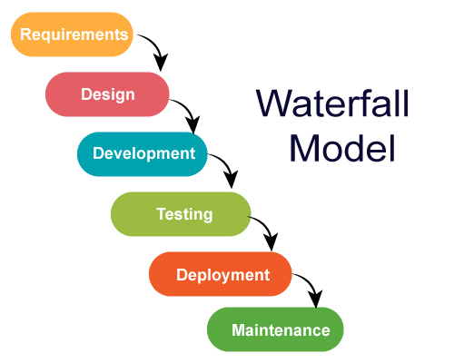
Process Models
Waterfall Model
The waterfall model is a sequential, plan-driven process where you must plan and schedule all your activities before starting the project. Each activity in the waterfall model is represented as a separate phase arranged in linear order.
It has the following phases:
Requirements
Design
Implementation
Testing
Deployment
Maintenance

Slide 18
Process Models
Waterfall Strengths
Easy to understand, easy to use
Provides structure to inexperienced staff
Milestones are well-understood
Sets requirements stability
Good for management control (plan, staff, track)
Works well when quality is more important than cost or schedule
Waterfall Deficiencies
All requirements must be known upfront
Deliverables created for each phase are considered frozen – inhibits flexibility
Not ideal for long, complex, or evolving projects where more flexibility is required
Does not reflect the problem-solving nature of software development – iterations of phases
Integration is one big bang at the end
Little opportunity for the customer to preview the system (until it may be too late)
When to use
Requirements are very well-known
Product definition is stable. Technology is understood
The new version of an existing product. Porting an existing product to a new platform.
Useful for small, one-time projects with few requirements and short timelines

Slide 19
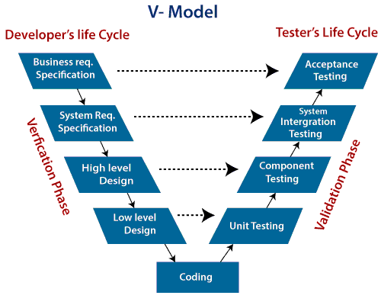
Process Models
The V model (Verification and Validation model) is an extension of the waterfall model. All the requirements are gathered at the start and cannot be changed. You have a corresponding testing activity for each stage. For every phase in the development cycle, there is an associated testing phase.

Slide 20
Process Models
V Model Strengths
Emphasize planning for verification and validation of the product in the early stages of product development
Each deliverable must be testable
Project management can track progress by milestones
Easy to use
V Model Weakness
Does not easily handle concurrent events
Does not handle iterations or phases
Not ideal for long, complex, or ongoing projects
Does not easily handle dynamic changes in requirements
Does not contain risk analysis activities
When to use
Excellent choice for systems requiring high reliability – hospital patient control applications
All requirements are known up-front
When it can be modified to handle changing requirements beyond the analysis phase
Solution and technology are known

Slide 21
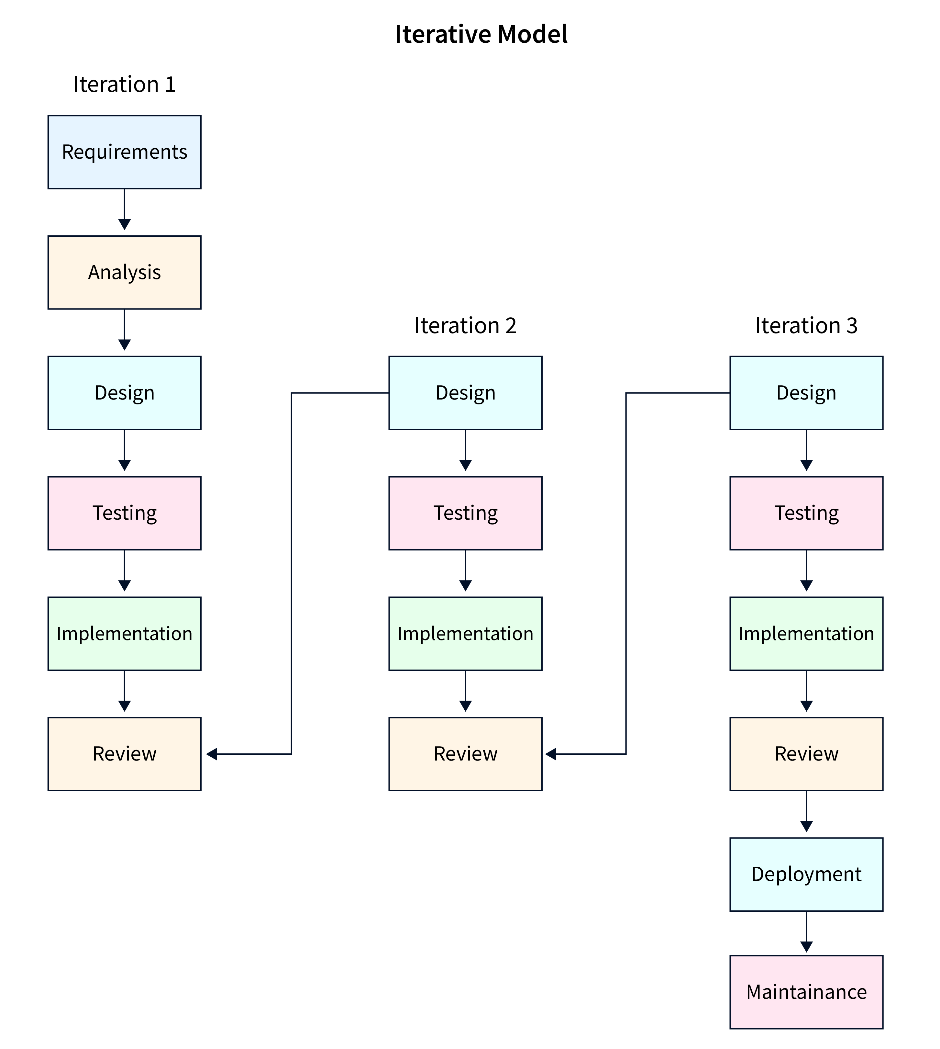
Process Models
Iterative Model
The iterative development model develops a system by building small portions of all the features. This helps to meet the initial scope quickly and release for feedback.
This process model starts with part of the software, which is then implemented and reviewed to identify further requirements.
Flexibility: Iterative development is highly flexible and adaptive to changes in requirements, making it suitable for projects with evolving needs.
Continuous Improvement: The iterative approach allows for continuous refinement. successive cycles, resulting in a potentially more polished end product.
Client Involvement: Regular feedback cycles involve clients throughout the development process, ensuring that the product aligns closely with their expectations.
Advantages: Allows refinement through iterations, more flexibility in design and development.
Disadvantages: Can be difficult to manage if iterations are not well-defined.

Slide 22
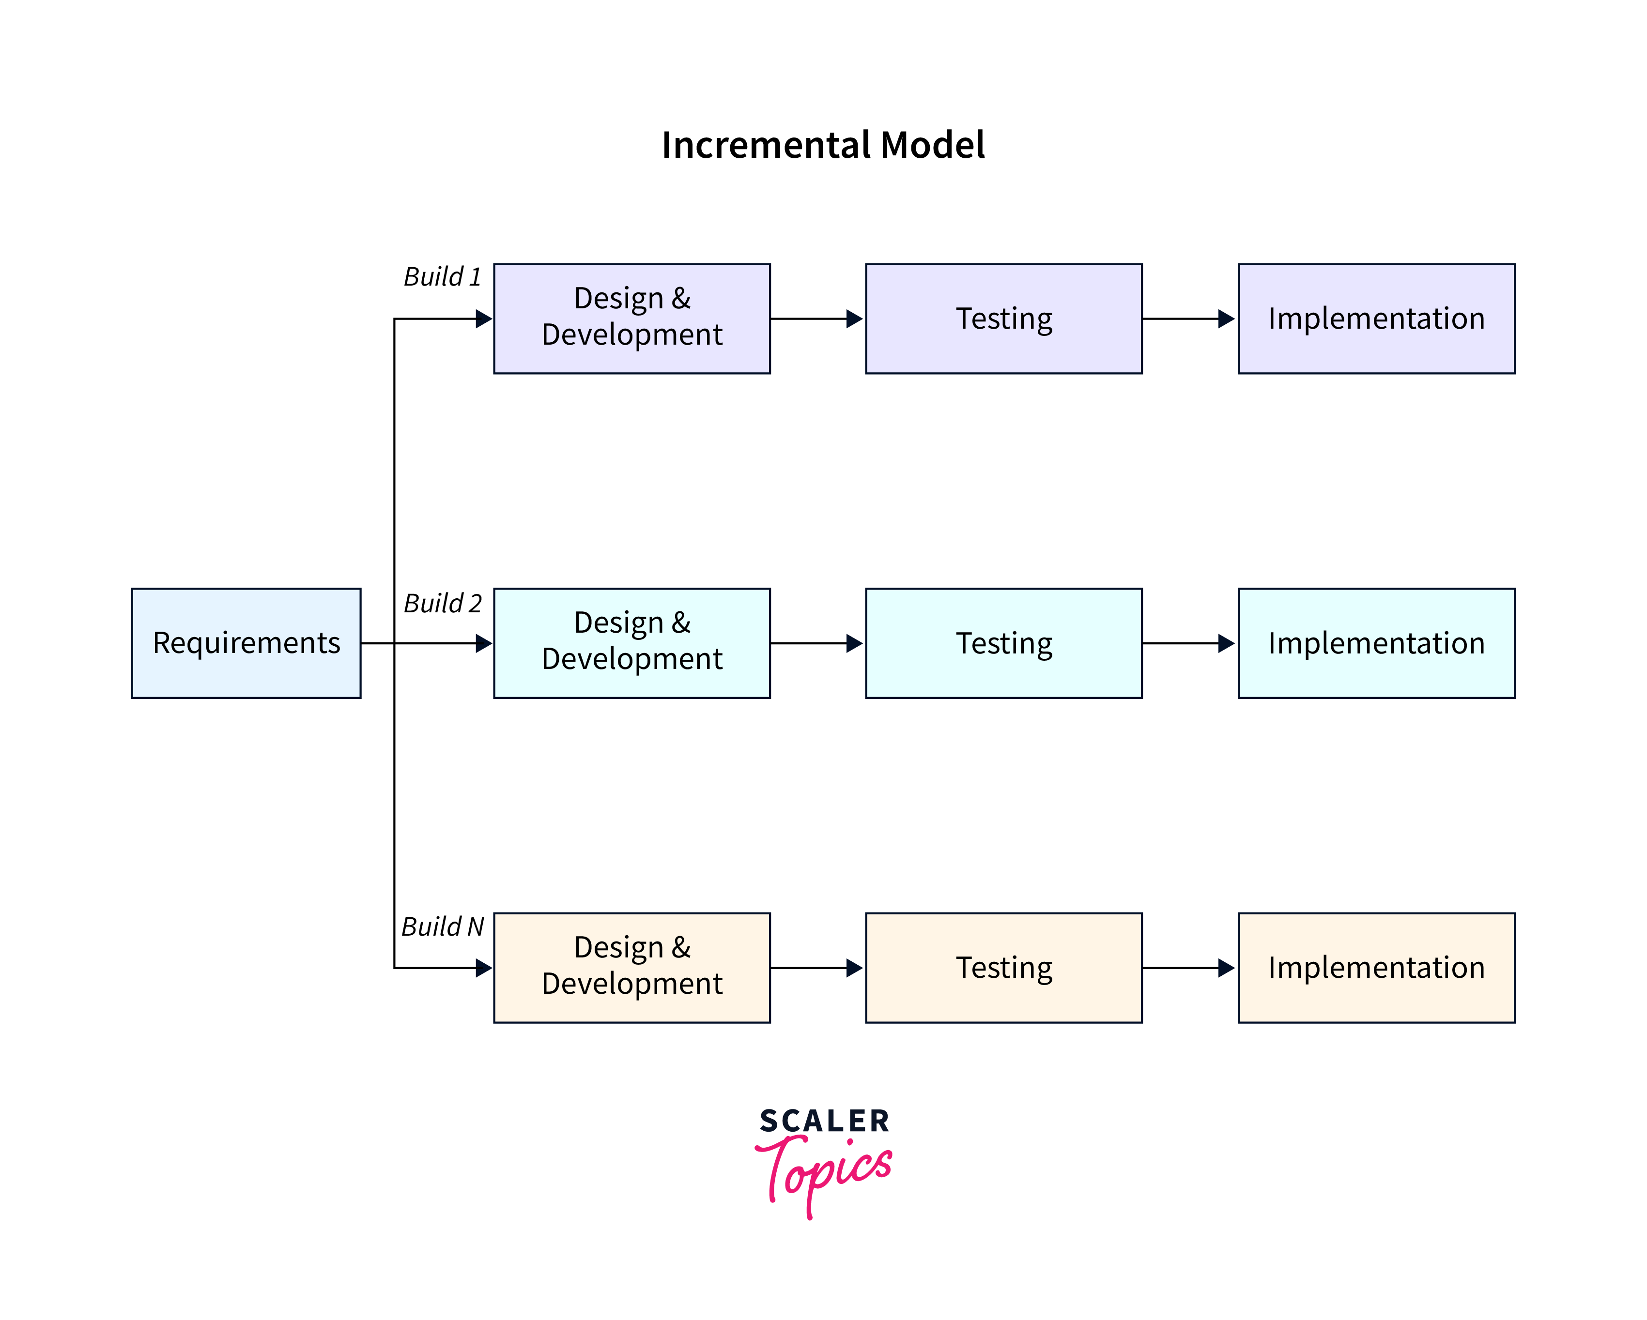
Process Models
Incremental Model
The incremental model divides the system’s functionality into small increments that are delivered one after the other in quick succession.
The most important functionality is implemented in the initial increments. The subsequent increments expand on the previous ones until everything has been updated and implemented.
Incremental development is based on developing an initial implementation, exposing it to user feedback, and evolving it through new versions. The process’ activities are interwoven by feedback.
Early Delivery: Incremental development allows for the early delivery of functional parts of the system, providing tangible benefits to clients sooner in the project timeline.
Partial Functionality: Clients can start using and benefiting from partial functionality earlier, which can be crucial in projects where rapid deployment of certain features is vital.
Easier Management: Each increment can be managed as a standalone project, simplifying control and monitoring of progress

Slide 23
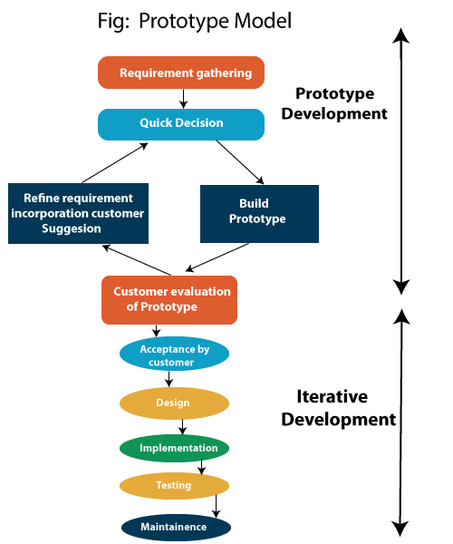
Process Models
Prototyping is defined as the process of developing a working replication of a product or system that has to be engineered. It offers a small-scale facsimile of the end product and is used for obtaining customer feedback.
The Prototyping Model is one of the most popularly used SDLC models. This model is used when the customers do not know the exact project requirements beforehand.
Steps of Prototype Model
Requirement Gathering and Analyst
Quick Decision
Build a Prototype
Assessment or User Evaluation
Prototype Refinement
Engineer Product

Slide 24
Process Models
Advantages of Prototype Model
Reduce the risk of incorrect user requirement
Good where requirements are changing/uncommitted
Regular visible process aids management
Support early product marketing
Reduce Maintenance costs.
Errors can be detected much earlier as the system is made side by side.
Disadvantage of Prototype Model
An unstable/badly implemented prototype often becomes the final product.
Require extensive customer collaboration
Costs customers money
Needs committed customer
Difficult to finish if customer withdraw
May be too customer-specific, no broad market
Difficult to know how long the project will last.
Easy to fall back into the code and fix without proper evaluation, and feedback.
Prototyping tools are expensive. Special tools & techniques are required to build a prototype.
It is a time-consuming process.

Slide 25
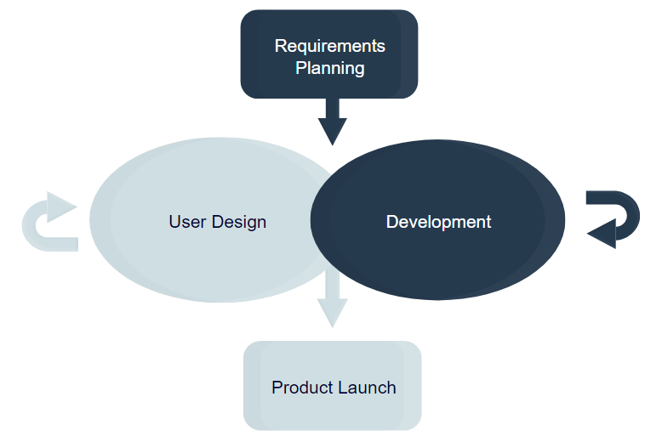
Process Models
RAD Model
The Rapid Application Development (RAD model) is based on iterative development and prototyping with little planning involved. You develop functional modules in parallel for faster product delivery. It involves the following phases:
Business modeling
Data modeling
Process modeling
Application generation
Testing and turnover
The RAD concept focuses on gathering requirements using focus groups and workshops, reusing software components, and informal communication.
It accommodates changing requirements, reduces development time, and increases the reusability of components. But it can be complex to manage. Therefore, the RAD model is great for systems that need to be produced in a short time and have known requirements.

Slide 26
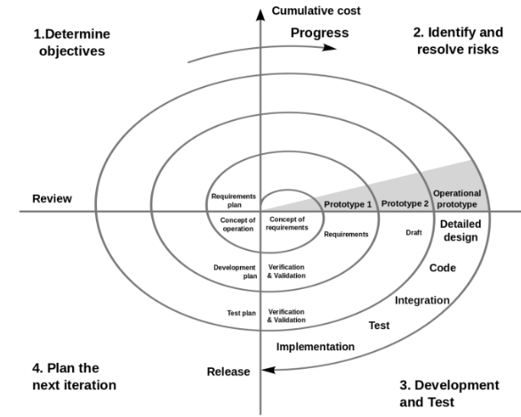
Process Models
Spiral Model
The spiral model is a risk-driven iterative software process model. The spiral model delivers projects in loops. Unlike other process models, its steps aren’t activities but phases for addressing whatever problem has the greatest risk of causing a failure.
You have the following phases for each cycle:
Address the highest-risk problem and determine the objective and alternate solutions
Evaluate the alternatives and identify the risks involved and possible solutions
Develop a solution and verify if it’s acceptable
Plan for the next cycle
It was designed to include the best features from the waterfall and introduce risk-assessment.

Slide 27
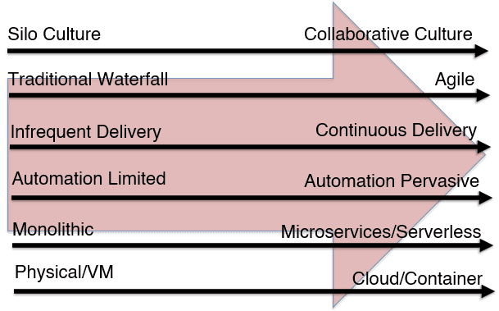
The Transformation
Every model was created to improve the software development and delivery process. Today, every software development model works well for specific types of projects. However, older manual models, like Waterfall, are quickly becoming a thing of the past.
IT teams, and businesses at large, must move faster and more effectively to deliver software, please their end-users, and keep up with the competition. A faster, repeatable, and more secure software development process is anchored in automation.
This level of automation and speed is not attainable with many models. As a result, the Agile methodology has become increasingly popular.
Companies are adopting enabling technologies and processes like continuous integration, continuous delivery, release automation, and DevOps.

Slide 28
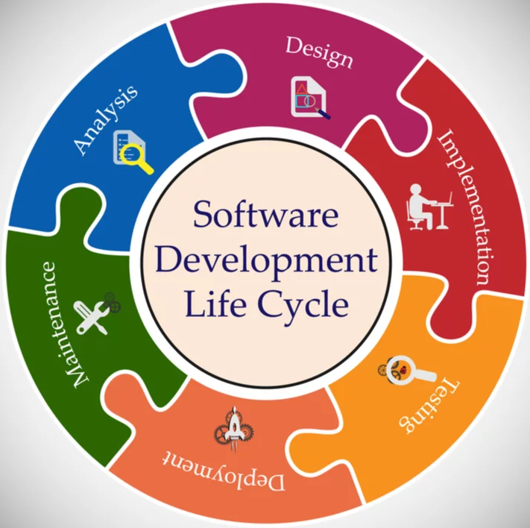
Software Engineering - SDLC

Slide 29
Requirement Engineering
What is Requirement? (1) A condition or capability needed by a user to solve a problem or achieve an objective. (2) A condition or capability that must be met or possessed by a system or system component to satisfy a contract, standard, specification, or other formally imposed documents.
What is Requirements Engineering?
A systematic and strict approach to the definition, creation, and verification of requirements for a software system is known as requirements engineering. To guarantee the effective creation of a software product, the requirements engineering process entails several tasks that help in understanding, recording, and managing the demands of stakeholders.
Type of Requirements –
Business Requirements
Customer Requirements
Functional Requirements
Non-functional Requirements
Quality / Testing Requirements
Technology requirement Requirements
Implementation/Transition Requirements

Slide 30
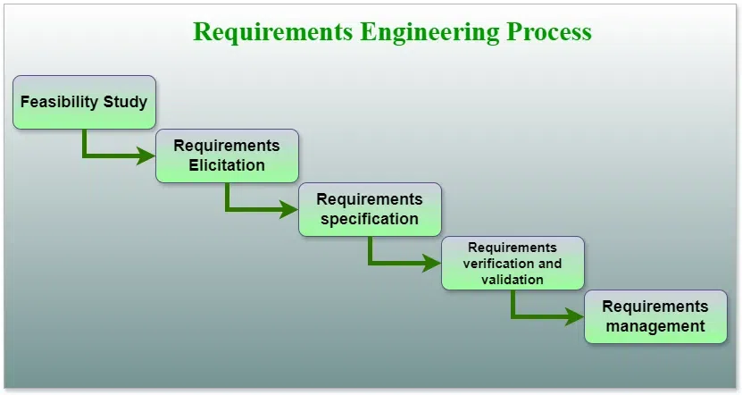
Requirement Engineering
Requirements Engineering Process
Feasibility Study
Requirements elicitation
Requirements specification
Requirements for verification and validation
Requirements management

Slide 31
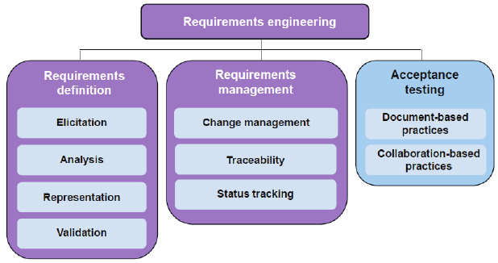
Requirement Engineering

Slide 32
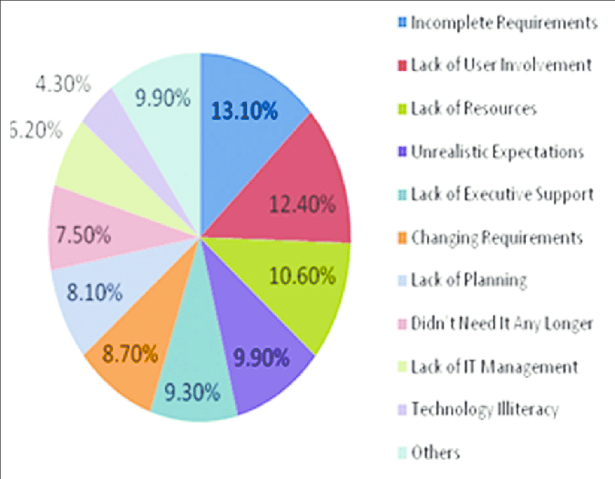
Requirement Engineering
Why do Projects fail ? – Current Survey

Slide 33
Requirement Engineering
Objectives of Analysis Modelling
Understanding Needs: The process of analysis modeling helps in the understanding and extraction of user needs for the software system.
Communication: Analysis models facilitate communication between users, clients, developers, and testers, among other stakeholders.
Clarifying Ambiguities: Analysis models assist in resolving requirements disputes and providing clarification on unclear areas.
Finding the Data Requirements: Analysis modeling assists in determining the relationships, entities, and qualities of the data that the system needs.
Defining Behavior: Analysis modeling aids in the definition of the system’s dynamic behavior, including workflows, processes, and inter-component interactions.
System Boundary Identification: It is made easier by analysis, which helps in defining the parameters of the software system and its interactions with users, other systems, and hardware components.

Slide 34
Requirement Engineering
Requirement Analysis Techniques
Business process modeling notation (BPMN)
BPMN (Business Process Modeling & Notation) is a graphical representation of your business process using simple objects, which helps the organization to communicate in a standard manner. Various objects used in BPMN include
Flow objects
Connecting objects
Swim lanes
Artifacts.
UML (Unified Modeling Language)
UML is a modeling standard primarily used for the specification, development, visualization, and documentation of software systems. To capture important business processes and artifacts UML provides objects like
State
Object
Activity
Class diagram

Slide 35
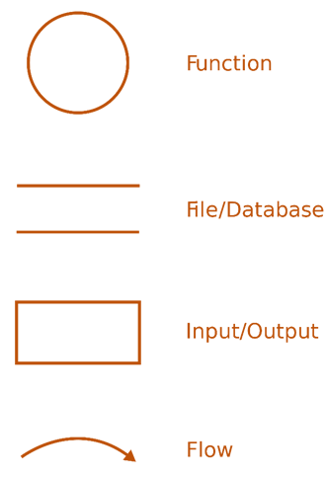
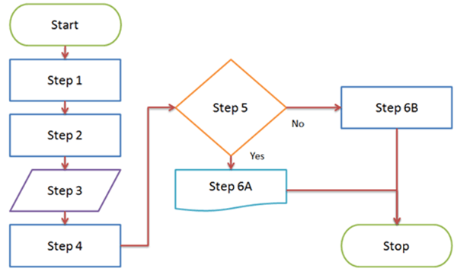
Requirement Engineering
Data flow diagram
Data flow diagrams show how data is processed by a system in terms of inputs and outputs. Components of the data flow diagram include
Process
Flow
Store
Terminator
Flow chart technique
A flowchart is a visual representation of the sequential flow and control logic of a set of related activities or actions. There are different formats for flowcharts which include Linear, Top-down and cross-functional (swim lanes)

Slide 36
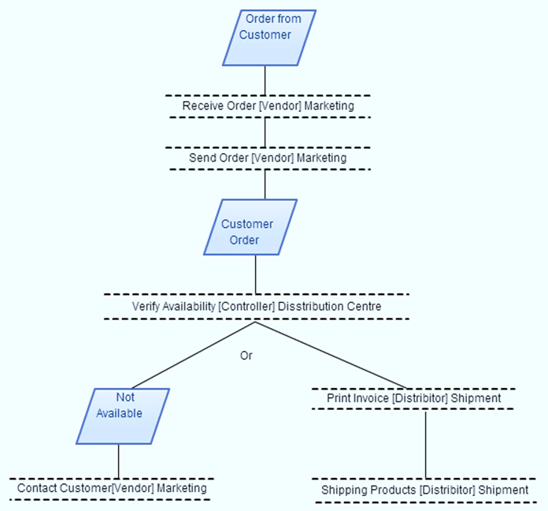
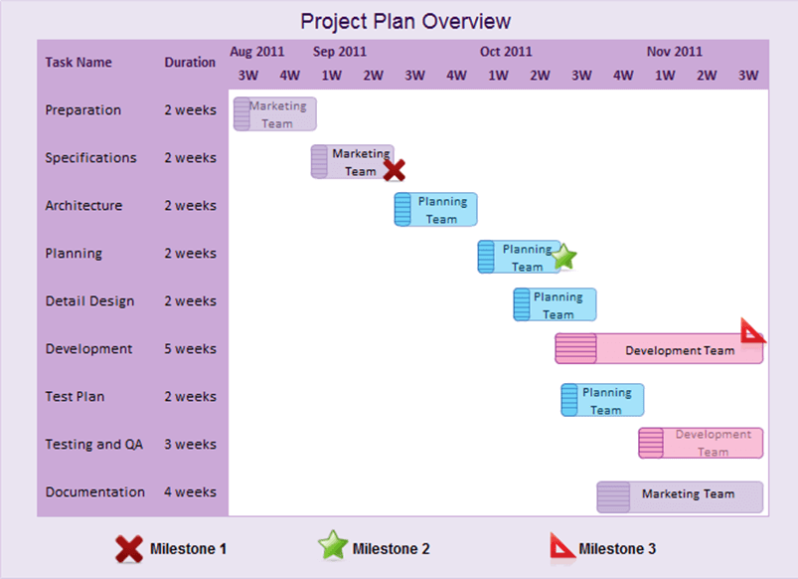
Requirement Engineering
Role Activity Diagrams- (RAD)
It is similar to flowchart-type notation. In RAD, role instances are process participants, which have start and end states. RAD requires a deep knowledge of process or organization to identify roles.
- External events, Activities, States
Gantt Charts
A Gantt chart is a graphical representation of a schedule that helps to coordinate, plan, and track specific tasks in a project. It represents the total period of the object, broken down into increments.

Slide 37
UML - Unified Modeling Language
Unified Modeling Language (UML) is a general-purpose modeling language.
The main aim of UML is to define a standard way to visualize how a system has been designed.
It is quite similar to blueprints used in other fields of engineering.
UML is not a programming language; it is rather a visual language.
Benefits - Standardization, Communication, Visualization, Documentation, Analysis and Design
Structural Diagrams – Capture static aspects or structure of a system
Behavior Diagrams – Capture dynamic aspects or behavior of the system
(UML) diagrams involve a systematic process that typically includes the following steps:
Identify the Purpose
Identify Elements and Relationships
Select the Appropriate UML Diagram Type
Create a Rough Sketch
Choose a UML Modeling Tool
Create the Diagram and Define Element Properties
Add Annotations and Comments
Validate and Review Refine and Iterate
Generate Documentation

Slide 38
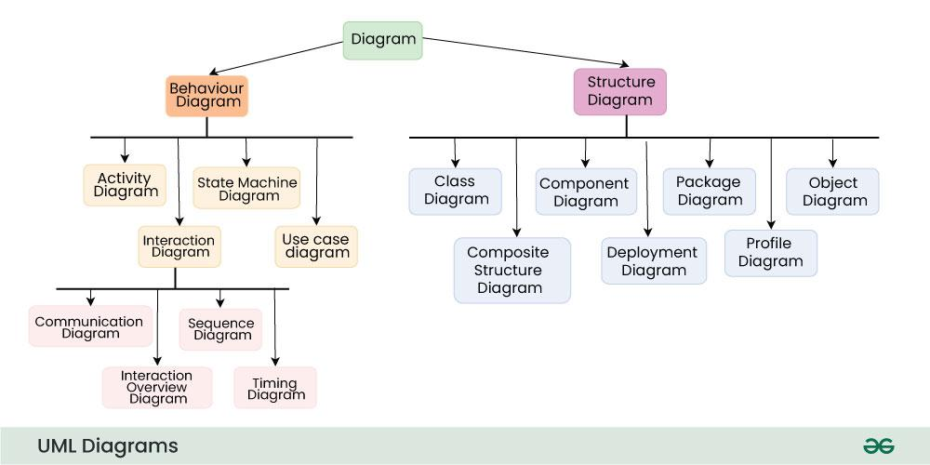
UML- Unified Modeling Language

Slide 39
Requirement Engineering
Use Cases
A use case is a written description of how users will perform tasks on your website. It outlines, from a user’s point of view, a system’s behavior as it responds to a request. Each use case is represented as a sequence of simple steps, beginning with a user's goal and ending when that goal is fulfilled.
Benefits of Use Cases
Help explain how the system should behave, and in the process, they also help brainstorm what could go wrong. They provide a list of the goals, and this list can be used to establish the cost and complexity of the system.
What Use Cases Include
Who is using (Actor)
What the user wants (Use Case Description)
The user's goal (Objective)
The steps the user takes to accomplish a particular task (Main and Alternative scenario, Extensions)
How the website should respond to an action (Post Condition)
What Use Cases Do NOT Include
Implementation-specific language
Details about the user interfaces or screens

Slide 40
Requirement Engineering
Use Case Name | Login
Use case Description | A user login to System to access the functionality of the system.
Actors | Parents, Students, Teacher, Admin
Pre-Condition | System must be connected to the network.
Post -Condition | After a successful login a notification mail is sent to the User mail id
Main Scenarios | Serial No | Steps
 | 1 | Enter username Enter Password
 | 2 | Validate Username and Password
 | 3 | Allow access to System
Extensions | 1a | Invalid Username System shows an error message
 | 2b | Invalid Password System shows an error message
 | 3c | Invalid Password for 4 times Application closed

Slide 41
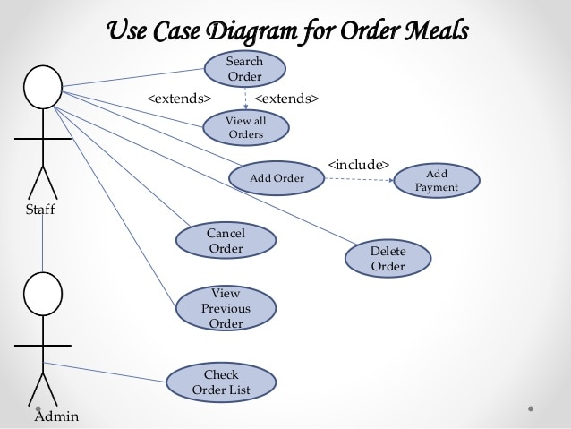
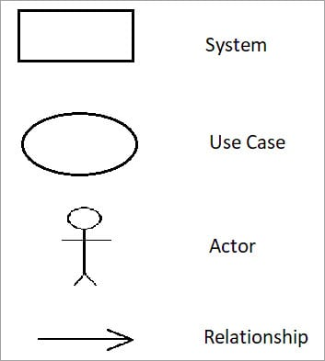
Requirement Engineering

Slide 42
Software Designing
Software Design
Software design is a mechanism to transform user requirements into some suitable form, which helps the programmer in software coding and implementation. It deals with representing the client's requirement, as described in the SRS (Software Requirement Specification) document, into a form, i.e., easily implementable using a programming language.
Objectives of Software Design
Correctness: Software design should be correct as per requirement.
Completeness: The design should have all components like data structures, modules, external interfaces, etc.
Efficiency: Resources should be used efficiently by the program.
Flexibility: Able to modify on changing needs.
Consistency: There should not be any inconsistency in the design.
Maintainability: The design should be simple so that it can be easily maintainable by other designers.

Slide 43
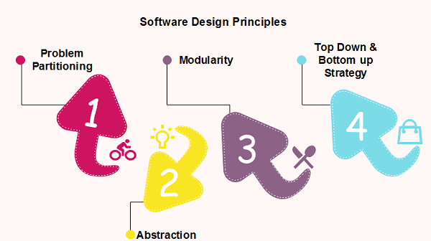
Software Designing
Software design principles are concerned with providing means to handle the complexity of the design process effectively. Effectively managing the complexity will not only reduce the effort needed for design but can also reduce the scope of introducing errors during design.

Slide 44
Software Designing
Problem Partitioning
Benefits –
Software is easy to understand
Software becomes simple
Software is easy to test
Software is easy to modify
Software is easy to maintain
Software is easy to expand
These pieces cannot be entirely independent of each other as they together form the system. They have to cooperate and communicate to solve the problem. This communication adds complexity.

Slide 45
Software Designing
Abstraction
An abstraction is a tool that enables a designer to consider a component at an abstract level without bothering about the internal details of the implementation. Abstraction can be used for existing elements as well as the components being designed.
Abstraction mechanisms -
Functional Abstraction
Data Abstraction
Functional Abstraction
A module is specified by the method it performs.
The details of the algorithm to accomplish the functions are not visible to the user of the function.
Functional abstraction forms the basis for Function-oriented design approaches.
Data Abstraction
Details of the data elements are not visible to the users of the data. Data Abstraction forms the basis for object-oriented design approaches.

Slide 46
Software Designing
Strategy of Design
A good system design strategy is to organize the program modules in such a method that is easy to develop and later too, change. Structured design methods help developers to deal with the size and complexity of programs. Analysts generate instructions for the developers about how code should be composed and how pieces of code should fit together to form a program.
To design a system, there are two possible approaches:
Top-down Approach
Bottom-up Approach
Top-down Approach: This approach starts with the identification of the main components and then decomposing them into their more detailed sub-components
Bottom-up Approach: A bottom-up approach begins with the lower details and moves towards the hierarchy, as shown in Fig. This approach is suitable in the case of an existing system

Slide 47
Software Designing
Modularity
Modularity specifies the division of software into separate modules which are differently named and addressed and are integrated later on in to obtain the completely functional software.
It is the only property that allows a program to be intellectually manageable.
Single large programs are difficult to understand and read due to a large number of reference variables, control paths, global variables, etc.
Each module is a well-defined system that can be used with other applications.
Each module has a single specified objective.
Modules can be separately compiled and saved in the library.
Modules should be easier to use than to build.
Modules are simpler from the outside than inside.
Modularity Design
Functional Independence
Information hiding

Slide 48
Software Designing
Advantages of Modularity
It allows large programs to be written by several or different people
It encourages the creation of commonly used routines to be placed in the library and used by other programs.
It simplifies the overlay procedure of loading a large program into main storage.
It provides more checkpoints to measure progress.
It provides a framework for complete testing, more accessible to test
It produced a well-designed and more readable program.
Disadvantages of Modularity
Execution time may, but not certainly, longer
Storage size perhaps, but is not certainly, increased
Compilation and loading time may be longer
Inter-module communication problems may be increased
More linkage is required, run-time may be longer, more source lines must be written, and more documentation has to be done

Slide 49
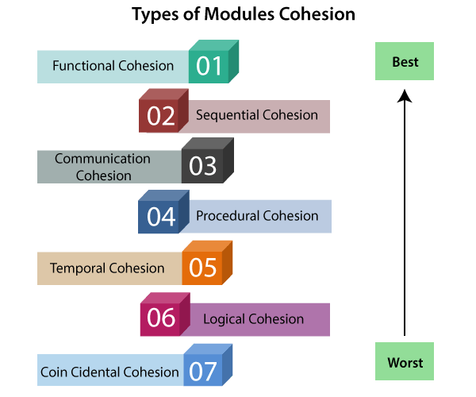
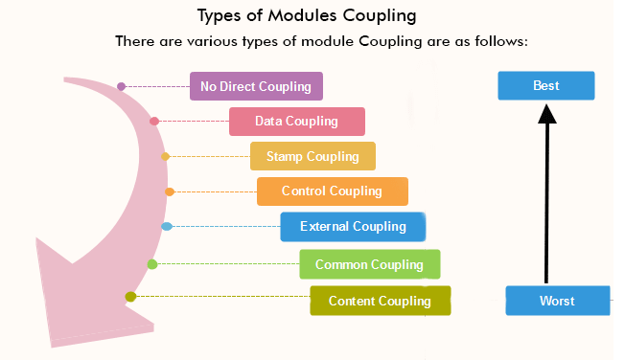
Software Designing
Cohesion: It measures the relative function strength of a module.
Coupling: It measures the relative interdependence among modules

Slide 50
Software Designing
Cohesion - A good software design will have high cohesion
Functional Cohesion: Functional Cohesion is said to exist if the different elements of a module, cooperate to achieve a single function.
Sequential Cohesion: A module is said to possess sequential cohesion if the element of a module forms the components of the sequence, where the output from one component of the sequence is input to the next.
Communicational Cohesion: A module is said to have communicational cohesion, if all tasks of the module refer to or update the same data structure, e.g., a set of functions defined on an array stack.
Procedural Cohesion: A module is said to be procedural cohesion if the set of purposes of the module are all parts of a procedure in which a particular sequence of steps has to be carried out to achieve a goal, e.g., the algorithm for decoding a message.
Temporal Cohesion: When a module includes functions that are associated with the fact that all the methods must be executed at the same time, the module is said to exhibit temporal cohesion.
Logical Cohesion: A module is said to be logically cohesive if all the elements of the module perform a similar operation. For example, Error handling, data input and data output, etc.
Coincidental Cohesion: A module is said to have coincidental cohesion if it performs a set of tasks that are associated with each other very loosely, if at all.

Slide 51
Software Designing
Coupling - A good software design will have low coupling
No Direct Coupling: There is no direct coupling between M1 and M2.
Data Coupling: When data of one module is passed to another module, this is called data coupling.
Stamp Coupling: Two modules are stamp coupled if they communicate using composite data items such as structure, objects, etc. When the module passes a non-global data structure or entire structure to another module, they are said to be stamp coupled. For example, passing structure variable in C or object in C++ language to a module.
Control Coupling: Control Coupling exists among two modules if data from one module is used to direct the structure of instruction execution in another.
External Coupling: External Coupling arises when two modules share an externally imposed data format, communication protocols, or device interface. This is related to communication with external tools and devices.
Common Coupling: Two modules are commonly coupled if they share information through some global data items.

Slide 52
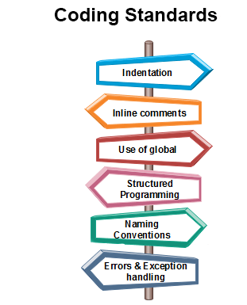
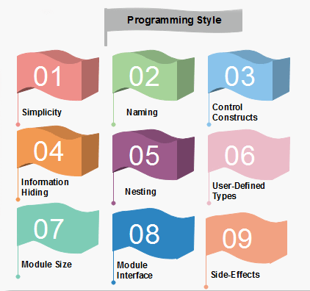
Software Development Standards
Goals of Coding
To translate the design of the system into a computer language format
Making the program more readable
To reduce the cost of later phases

Slide 53
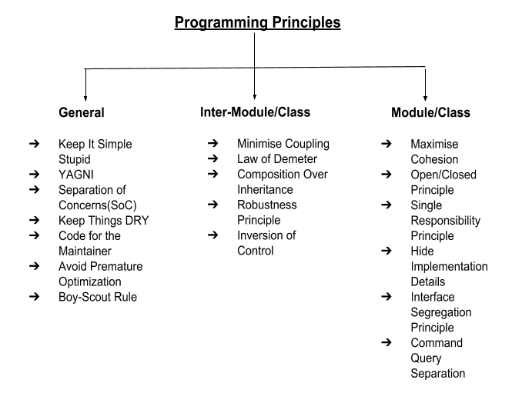
Software Engineering Programming Basics

Slide 54
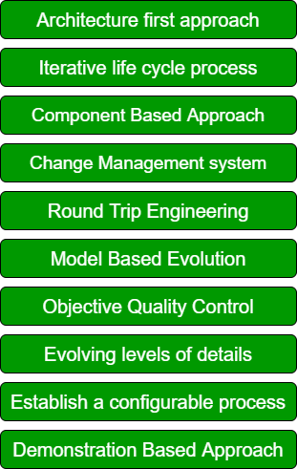
Software Development Modern Principles
Why ?
What ?
Complexity management
Consistency
Risk mitigation
Quality enhancement
Efficiency and productivity
Adaptability
Communication and collaboration
Scalability and maintainability
Cost efficiency
User-centric approach

Slide 55
Software Development Principles
What is Object-Oriented Analysis and Design
OOA: we find and describe business objects or concepts in the problem domain. OOA introduces new concepts to investigate a problem
The information domain is modeled
Behavior is represented
The function is described
Data, functional, and behavioral models are divided to uncover greater detail
Starting Simple, Getting Detailed
OOD: we define how these software objects collaborate to meet the requirements. Attributes
Subsystem Partitioning
Object Encapsulation
Data Organization of Attributes
Procedural Description of Operations

Slide 56
Software Development Principles
Two Approaches of Software Development
Traditional Approach | Object oriented Approach
Collection of procedures | Combination of data and functions
Focuses on function and procedures different styles and methodologies for each step of process | Focuses on object, classes, modules that can be easily replaced, modifies and reused
Moving from one phase to another phase is complex | Moving from one phase to another phase is easier
Increases complexity | Reduce complexity and redundancy
Increases duration of the project | Decreases duration of the project

Slide 57
Software Development Principles
OOP: Implementation: we implement the design objects in, say, Java, C++, C#, etc.
Design Patterns
UML Diagrams
UML Diagrams
Object-oriented analysis and design (OOAD) is a popular technical approach for analyzing and designing an application, system, or business by applying the object-oriented paradigm and visual modeling throughout the development life cycles for better communication and product quality
Why an Object Orientation?
Higher level of abstraction.
The seamless transition between different phases of software development
Encouragement of goo
Promotion of reusability programming techniques

Slide 58
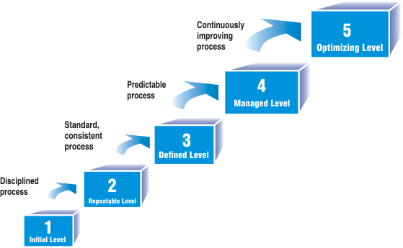
CMM
CMM was developed by the Software Engineering Institute (SEI) at Carnegie Mellon University in 1987. It is not a software process model. It is a framework that is used to analyze the approach and techniques followed by any organization to develop software products.
It also provides guidelines to further enhance the maturity of the process used to develop those software products. It is based on profound feedback and development practices adopted by the most successful organizations worldwide.
This model describes a strategy for software process improvement that should be followed by moving through 5 different levels.

Slide 59
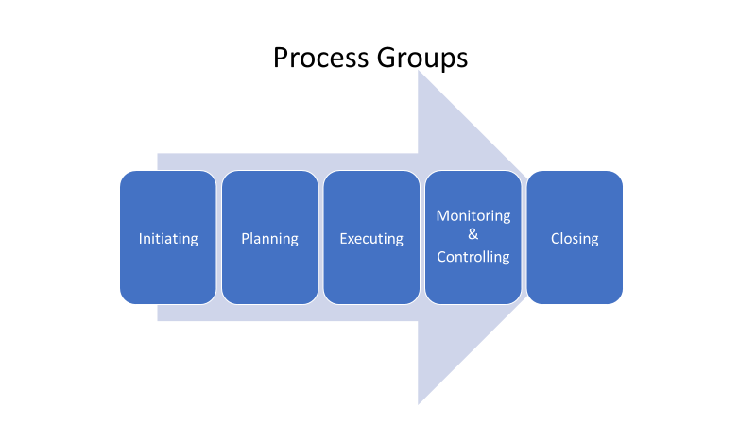
Software Project Management(SPM)

Slide 60
Software Estimation Measures
Estimation of the size of the software is an essential part of Software Project Management. It helps the project manager to further predict the effort and time that will be needed to build the project. Various measures are used in project size estimation. Some of these are:
Lines of Code
Number of entities in the ER diagram
Total number of processes in detailed data flow diagram
Function points

Slide 61
Software Testing – An Introduction
Software testing is a process of checking software applications and products is Bugs/Defects to ensure their performance is efficient. And whether the actual software product matches the expected requirements. It is more important to demonstrate that the software is not doing what it is not supposed to do. Testing in software engineering is a fundamental process of creating reliable – and usable – software products The goal of software testing is to find errors, gaps, or missing requirements in comparison to the actual requirements Testing is a DESTRUCTIVE PROCESS: A CREATIVE DESTRUCTION. Testing Needs a Negative Approach Successful testing requires a methodical approach Establishing the proper “Test to Break” mental attitude has a profound effect on testing success.

Slide 62
Testing is important because software bugs could be expensive or even dangerous. Software testing is required to identify errors >> Reduce flaws in the component or system. Software testing is required to Increase the overall quality of the system >> Gain customer. Confidence and satisfaction. Software testing is required to check software adaptability >> To accelerate software development and add new features. Software testing is required to avoid risks. Software testing is required to avoid extra costs >> To optimize business. Software testing is required to determine Software performance. Software testing is required to determine Software Security. Software testing is required to check the reliability of the software. Software testing is required to make sure that the final product is user-friendly.
Software Testing - Importance

Slide 63
Testing Shows the Presence of Defects - Every application or product is released into production after enough testing by different teams or passes through different phases like System Integration Testing, User Acceptance Testing, Beta Testing, etc. So, have you ever seen or heard from any of the testing teams that they have tested the software fully and there is no defect in the software? Instead of that, every testing team confirms that the software meets all business requirements, and it is functioning as per the needs of the end user. In the software testing industry, no one will say that there is no defect in the software, which is quite true as testing cannot prove that the software is error-free or defect-free. However, the objective of testing is to find more and more hidden defects using different techniques and methods. Testing can reveal undiscovered defects and if no defects are found then it does not mean that the software is defect-free. Early Testing – Testers need to get involved at an early stage of the Software Development Life Cycle (SDLC). Thus, the defects during the requirement analysis phase or any documentation defects can be identified. The cost involved in fixing such defects is much less when compared to those that are found during the later stages of testing.
Software Testing - Principles

Slide 64
Exhaustive Testing is Not Possible – It is not possible to test all the functionalities with all valid and invalid combinations of input data during actual testing. Instead of this approach, testing of a few combinations is considered based on priority using different techniques. Exhaustive testing is not possible. Instead, we need the optimal amount of testing based on the risk assessment of the application. Testing is Context-Dependent – There are several domains available in the market like Banking, Insurance, Medical, Travel, Advertisement etc. and each domain has several applications. Also, for each domain, their applications have different requirements, functions, different testing purpose, risk, techniques etc. Different domains are tested differently; thus testing is purely based on the context of the domain or application. For Example, testing a banking application is different than testing any e-commerce or advertising application. The risk associated with each type of application is different, thus it is not effective to use the same method, technique, and testing type to test all types of application. Defect Clustering – Defect Clustering which states that a small number of modules contain most of the defects detected. This is the application of the Pareto Principle to software testing: approximately 80% of the problems are found in 20% of the modules.
Software Testing - Principles

Slide 65
Pesticide Paradox - Pesticide Paradox principle says that if the same set of test cases are executed again and again over the period then these set of tests are not capable enough to identify new defects in the system. In order to overcome this “Pesticide Paradox”, the set of test cases needs to be regularly reviewed and revised. If required a new set of test cases can be added and the existing test cases can be deleted if they are not able to find any more defects from the system. Absence of Error - If the software is tested fully and if no defects are found before release, then we can say that the software is 99% defect free. But what if this software is tested against wrong requirements? In such cases, even finding defects and fixing them on time would not help as testing is performed on wrong requirements which are not as per needs of the end user. For Example, suppose the application is related to an e-commerce site and the requirements against “Shopping Cart or Shopping Basket” functionality which is wrongly interpreted and tested. Here, even finding more defects does not help to move the application into the next phase or in the production environment.
Software Testing - Principles

Slide 66
COQ -- Cost of Quality Prevention Cost Money required to prevent errors and to do the job right the first time. money spent on establishing methods and procedures Appraisal Cost Money spent to review completed products against requirements. Appraisal includes the cost of inspections, testing, and reviews. This money is spent after the product is built but before it is shipped to the user or moved into production. Failure Cost All costs associated with defective products that have been delivered to the user or moved into production.
Quality Concepts – Cost of Quality

Slide 67
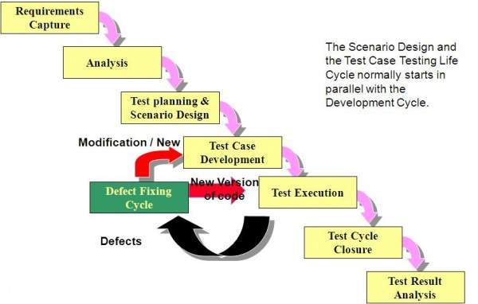
Software Testing Life Cycle

Slide 68
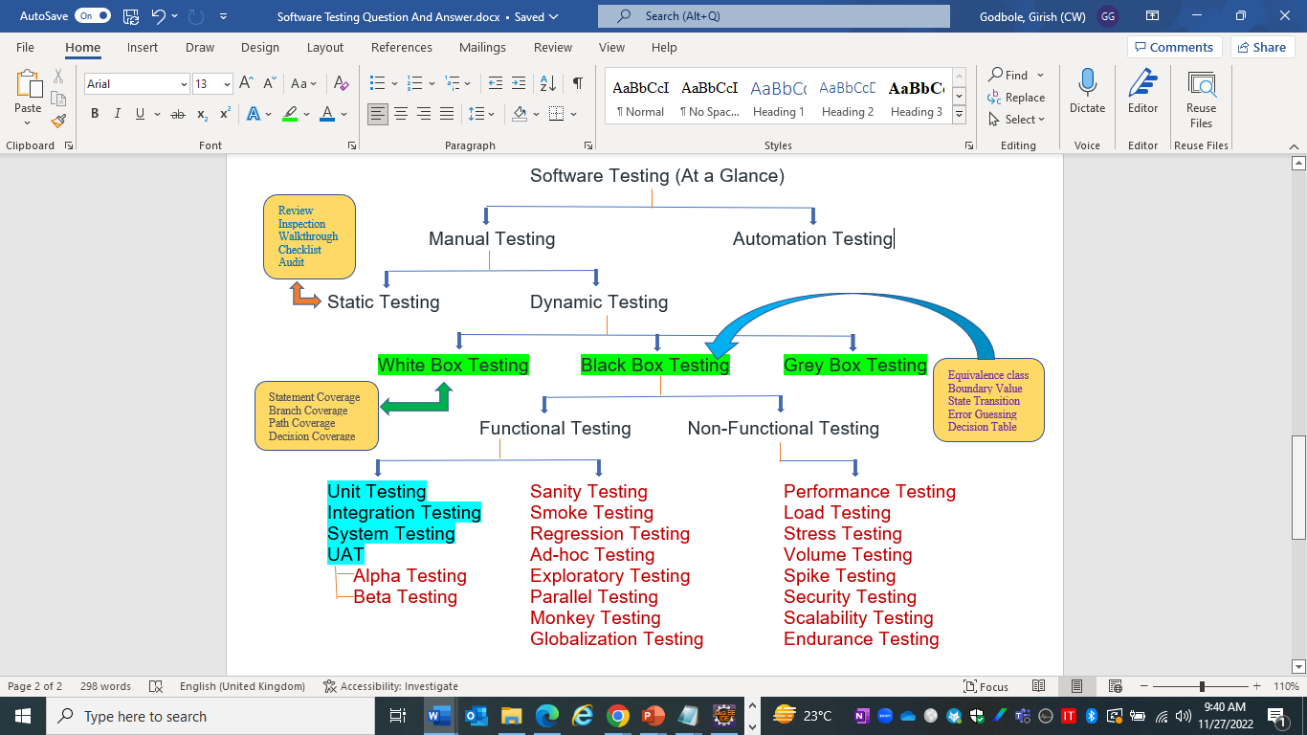
Software Testing – At a Glance

Slide 69
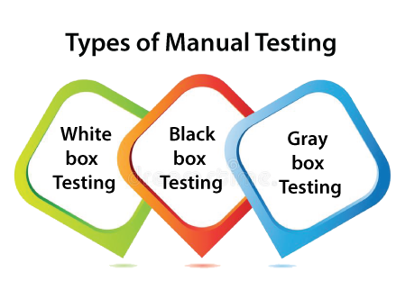
Software Testing Methodologies
White-box testing The white box testing is done by the Developer, who checks every line of code before giving it to the Test Engineer. Since the code is visible to the Developer during the testing, that's why it is also known as White box testing. Black box testing The black box testing is done by the Test Engineer, who can check the functionality of an application or the software according to the customer /client's needs. In this, the code is not visible while performing the testing; that's why it is known as black-box testing. Gray Box testing Gray box testing is a combination of white box and Black box testing. It can be performed by a person who knows both coding and testing. And if a single person performs white box, as well as black-box testing for the application, is known as Gray box testing.

Slide 70
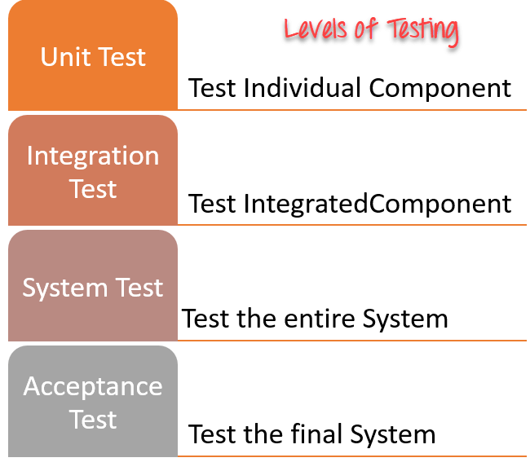
Levels of Software Testing
Unit Testing: In this type of testing, errors are detected individually from every component or unit by individually testing the components or units of software to ensure that if they are fit for use by the developers. It is the smallest testable part of the software.
Integration Testing: Two or more modules are integrated to test i.e., technique interacting components, and are then verified if these integrated modules work as per the expectation or not, and interface errors are also detected.
System Testing: In system testing, complete and integrated Software is tested i.e., all the system elements forming the system are tested as a whole to meet the requirements of the system.
Acceptance Testing: This testing is conducted to ensure that the requirements of the users are fulfilled before its delivery and that the software works correctly in the user’s working environment.

Slide 71
Types of Testing
Sanity Testing:
Testing technique which determines if a new software version is performing well enough to accept it for a major testing effort. It is performed by the testing teams
Smoke Testing: Testing technique which examines all the basic components of a software system to ensure that they work properly. Typically, smoke testing is conducted by the testing team, immediately after a software build is made Regression Testing: Type of software testing that seeks to uncover software errors after changes to the program (e.g. bug fixes or new functionality) have been made. It is performed by the testing teams. Parallel Testing:
A testing technique that has the purpose of ensuring that a new application that has replaced its older version has been installed and is running correctly. It is conducted by the testing team. Exploratory Testing:
Black box testing technique performed without planning and documentation. It is usually performed by manual testers.

Slide 72
Types of Testing
Usability Testing: Testing technique that verifies the ease with which a user can learn to operate, prepare inputs for, and interpret outputs of a system or component. It is usually performed by end users. Mutation Testing: Method of software testing which involves modifying programs’ source code or byte code in small ways to test sections of the code that are seldom or never accessed during normal tests execution. It is normally conducted by testers
End-to-End Testing: Like system testing, involves testing of a complete application environment in a situation that mimics real-world use, such as interacting with a database, using network communications, or interacting with other hardware, applications, or systems if appropriate. It is performed by QA teams:
Security Testing
A process to determine that an information system protects data and maintains functionality as intended. unveils the vulnerabilities of the system to ensure that the software system and application are free from any threats or risks
Cyclomatic complexity serves as a vital gauge in computer science, quantifying a program's complexity by counting its independent paths.

Slide 73
Types of Testing
Load Testing: Testing technique that puts demand on a system or device and measures its response. It is usually conducted by the performance engineers. Stress Testing: In this, we give unfavorable conditions to the system and check how it performs in those conditions. Performance Testing: It is designed to test the run-time performance of software within the context of an integrated system. It is used to test the speed and effectiveness of the program. It is also called load testing. In it, we check, what is the performance of the system in the given load. Volume Testing: Testing that confirms that any values that may become large over time (such as accumulated counts, logs, and data files), can be accommodated by the program and will not cause the program to stop working or degrade its operation in any manner. It is usually conducted by the performance engineer. Recovery Testing: Testing technique that evaluates how well a system recovers from crashes, hardware failures, or other catastrophic problems. It is performed by the testing teams
Compatibility Testing: Testing technique that validates how well a software performs in a particular hardware/software/operating system/network environment. It is performed by the testing teams.

Slide 74
Types of Testing
Scalability Testing: Part of the battery of non-functional tests that tests a software application for measuring its capability to scale up – be it the user load supported, the number of transactions, the data volume etc. It is conducted by the performance engineer. Penetration Testing: A testing method that evaluates the security of a computer system or network by simulating an attack from a malicious source. Usually, they are conducted by specialized penetration testing companies. Acceptance Testing: Formal testing is conducted to determine whether or not a system satisfies its acceptance criteria and to enable the customer to determine whether or not to accept the system. It is usually performed by the customer. Alpha Testing Alpha Testing is a type of software testing performed to identify bugs before releasing the software product to real users or the public, It is a type of acceptance testing that is done before the product is released to the end user and performed in a controlled environment. It is typically done by QA people. Beta Testing The beta test is conducted at one or more customer sites by the end-user of the software. This version is released for a limited number of users for testing in a real-time environment

Slide 75
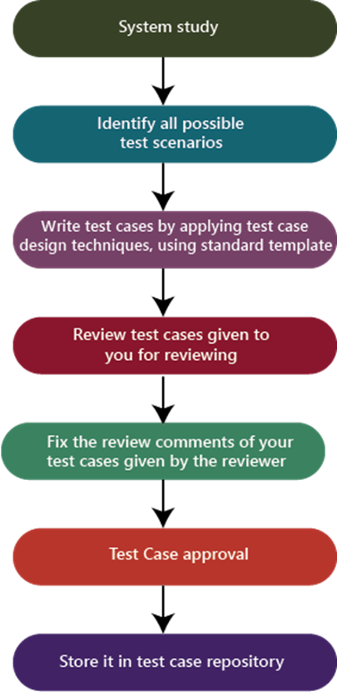
Test Case - Process

Slide 76
Best Practices To Write Good Test Case
Easy to understand and execute
Create Test Cases with End User’s perspective
Unique Test case Identifiers must be used. It allows us to track them easily.
Prerequisites should be listed clearly. Helps to execute the test case without any issues.
Test data should be defined to evaluate each functional area.
Test case description should be concise.
Test Steps should be in detail and clear.
Specify the exact expected result.
Position conditions should be listed if any.
Test cases should be neither too simple nor too complex.
Test cases must be distinctive. There should not be any repeated test cases.
Test cases should be written by following test case design techniques
Test cases must be comprehensible. So that any tester (even newly appointed testers) can understand them by perusing them once.
Needs to provide clear environment details where we need to execute them.
Test cases should be reusable & maintainable
Get peer review.

Slide 77
Test Case –Execution Flow
Generate Tests
Execute Tests
Store test Logs
Verify results
Generate Error Report
Bug Tracking

Slide 78
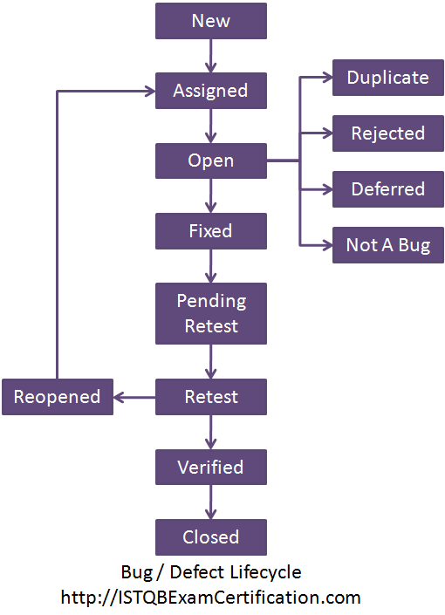
Defect Life Cycle

Slide 79
Defect –Priority, Severity, Density & Age
Defect Priority provides a perspective for the order of the defect fixes. Priority in other words tells us , how soon the defect must be fixed.
P1 – Fix the defect on highest priority, fix it before the next build
P2 – Fix the defect on high priority before the next test cycle
P3 – Fix the defect on moderate priority when time permits , before the release
P4- Postpone the defect for the next release or live with this defect.
Defect Severity provides the perspective of the impact of that defect in product functionality.
Defect Severity levels can be:
Extreme – Product Crashes or is unusable
Critical - Basic functionality of the product is not working.
Important- Extended functionality of the product not working
Minor – Product behaves differently
Cosmetic – GUI related
Defect Density is the number of defects detected per lines of code or per module
Defect Age is the period between the time the defect is detected and the time it was resolved
Defect Leakage is the metric that is used to identify the efficiency of the QA testing i.e., how many defects are missed/slipped during the QA testing

Slide 80
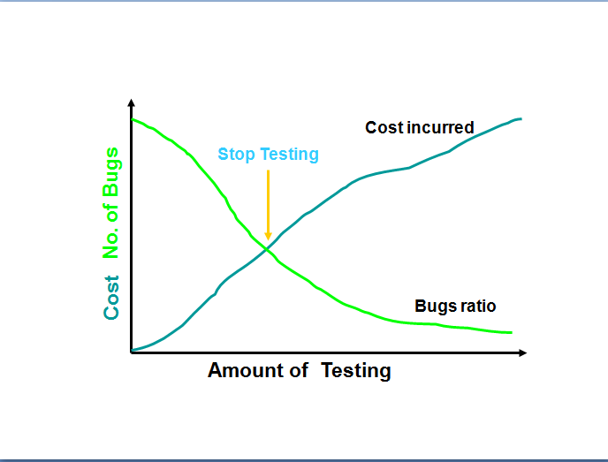
When to Stop Testing
Test Manager will consider the following factors
Deadlines, e.g. release deadlines, testing deadlines;
Test cases completed with certain percentage passed;
Test budget has been depleted;
Coverage of code, functionality or requirements reaches a specified point;
Bug rate falls below a certain level
Beta or alpha testing period ends

Slide 81


